Slide 1

IS POPULATION GROWTH A KEY DRIVER OF ECONOMIC GROWTH
Team members:
Oliver King
Ufuoma Atakere

Slide 2

In todays’ presentation
Project objectives
Database applications
dataset used:
criteria for country’s inclusion
population > 500,000
country have 30years (1990-2019) worth of data.
Lessons learned / Conclusion
Programming languages used.
World bank Data
Flask
Python
PostgreSQL
JavaScript/Html

Slide 3

Project Objectives
We propose to analyze the long-term relationship between a range of countries’ population growth rates and their economic growth rates to determine whether there is a statistically significant relationship.
we will break down population growth into its key drivers
net migration.
Natural birth rate,
Longevity
We would determine whether any of these key drivers have a statistically significant relationship with a country’s economic growth rate

Slide 4
What we did
Notes:
We sourced data from different websites but ended up with world bank database.
We scrotinized and cleaned the data with python and concluded with the data
Python Flask-powered API was used during the data gathering process.
PostgreSQL database was used to store and retrieve data using PgAdmin.
We used HTML/CSS and JavaScript for data visualisations and the charts.

Slide 5
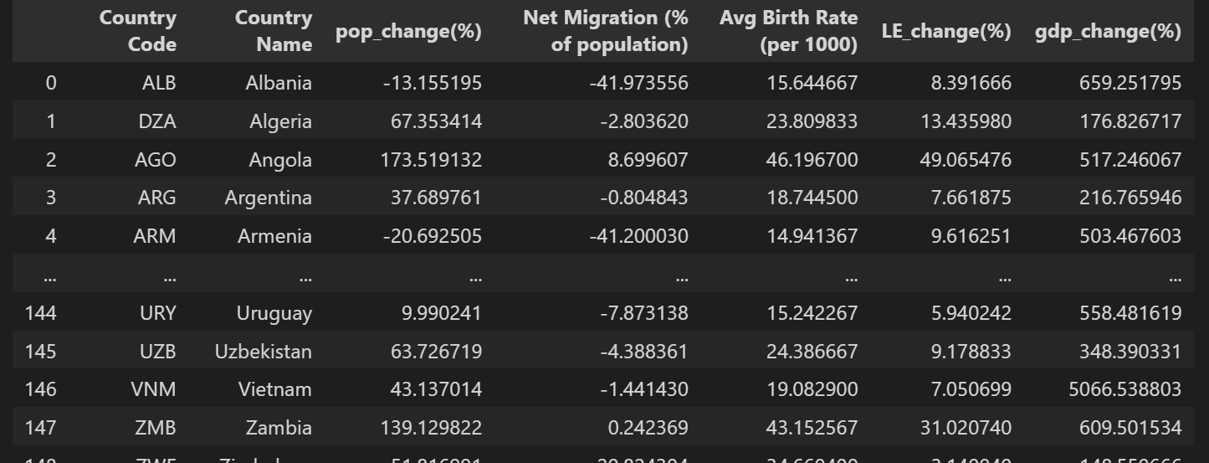
Python
Create: We performed some operations to read in the csv and clean the data
Read in the final csv
Updated the data by combining different data references and updating the existing one.
Delete all the data with null values thereby creating the dataset into the format we wanted and fed into PostgreSQL

Slide 6
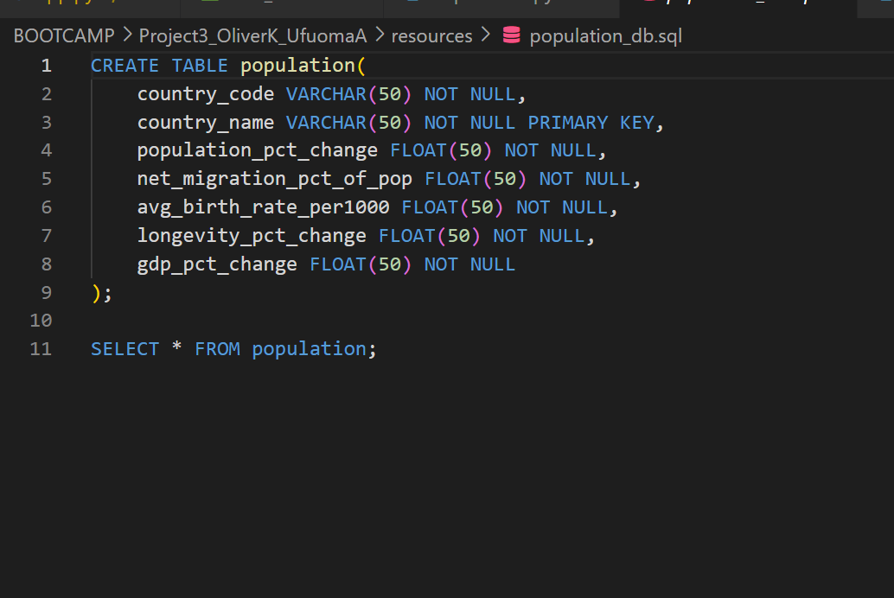
postgresSQL
Using PgAdmin
Create a database and a table with various columns and load in the csv.

Slide 7
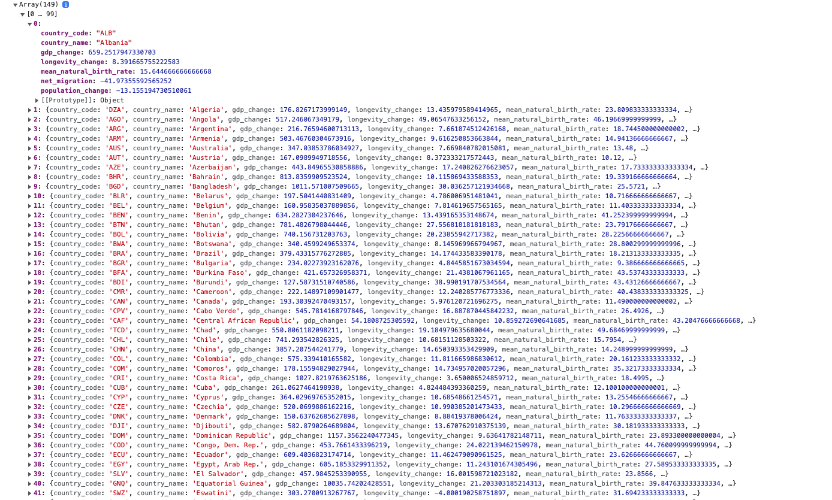
FLASK
Flask was used to develop the web applications to produce the data and JavaScript was used to pull from the dataset.
The dataset was stored as a list of dictionaries for easy access for JavaScript.

Slide 8
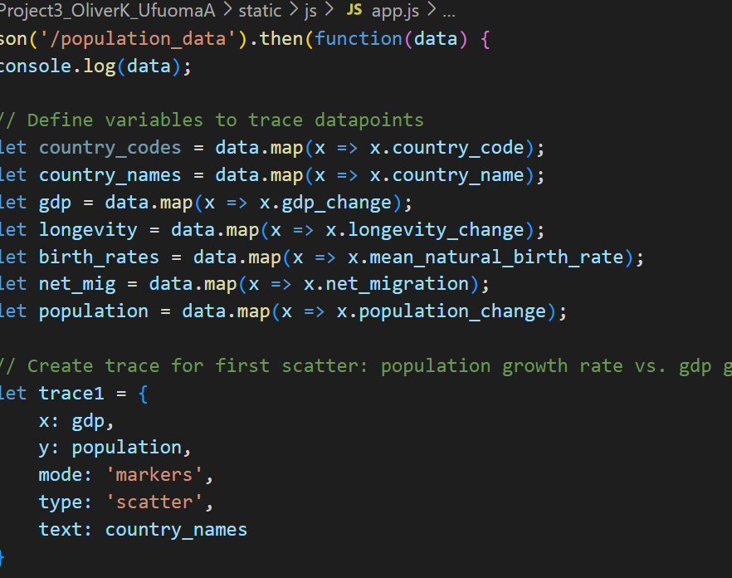
JavaScript
Was used to create dynamically updating content and visualize charts
It was used along with HTML and CSS to create the charts that can be seen and interacted with.
Data was read in from the database created using flask above.
It was used to get all the traces and plots to create all the charts and calculate the correlations.

Slide 9
visualizations
Python Flask-powered API was used during the data gathering process.
PostgreSQL database was used to store and retrieve data using PgAdmin.
We used HTML/CSS and JavaScript for data visualisations and the charts.

Slide 10
Conclusion

Slide 11
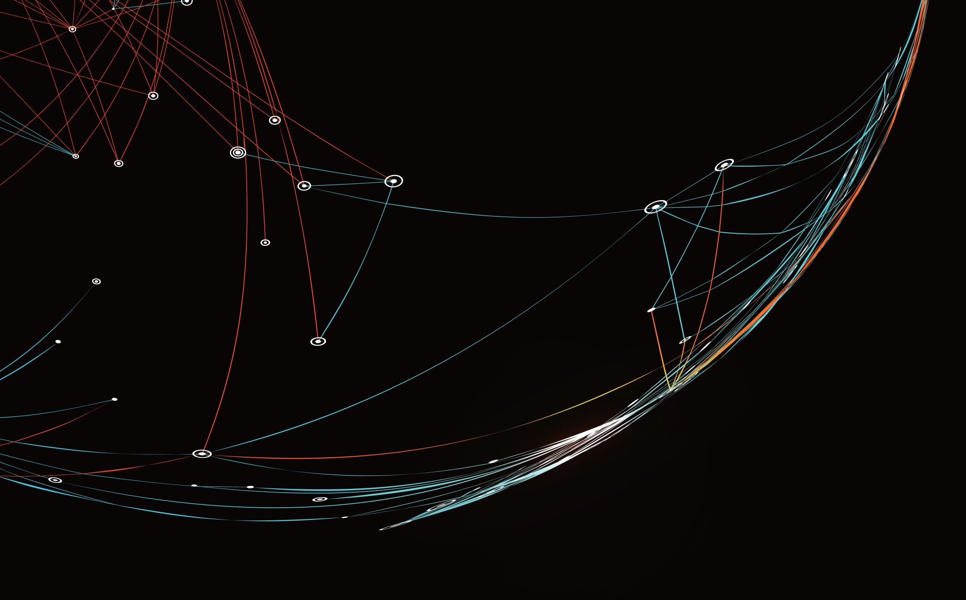
Thank you

